Slide 1

Smooth Signed Distance Surface Reconstruction
Seminar Course Computer Graphics
Winter Semester 2012
Author: Aljosa Osep
Mentor: Michael Weinmann

Slide 2
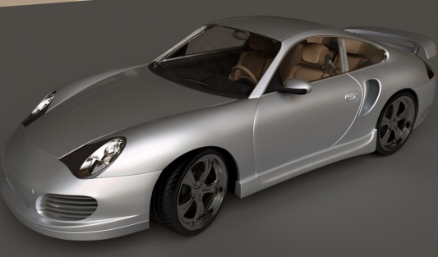
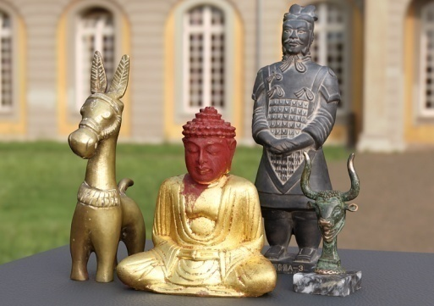
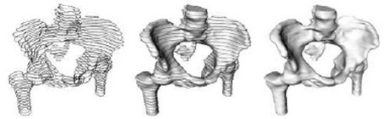
Motivation
Industry
Entertainment
Games, Movies
Cultural Heritage
Digitization of cultural heritage and artistic works
Medical Imaging
Visualization
Segmentation
Image credits: Uni Bonn, M. Kazhdan, M. Bolitho, H. Hoppe (bones)

Slide 3
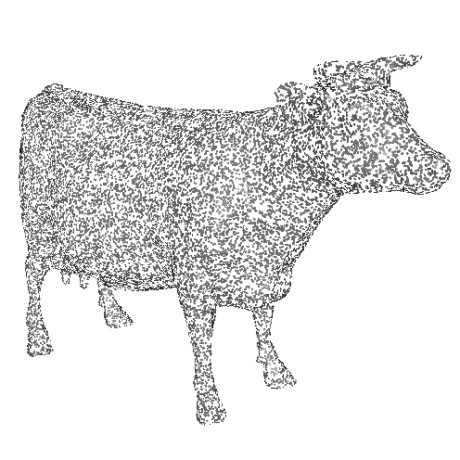
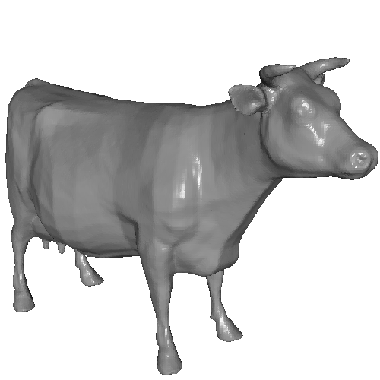
Surface Reconstruction
Generate a mesh from a set of (oriented) surface samples
Oriented points
Surface representation
Image credits: M. Kazhdan, M. Bolitho, H. Hoppe

Slide 4
Data Acqisition
Slide about that too?

Slide 5
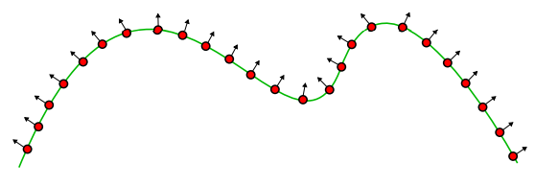
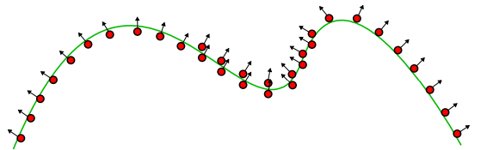
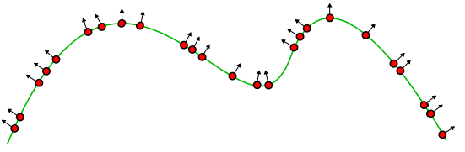
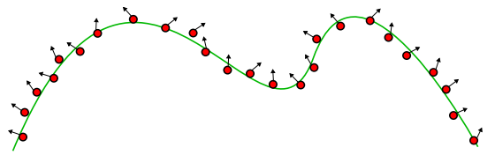
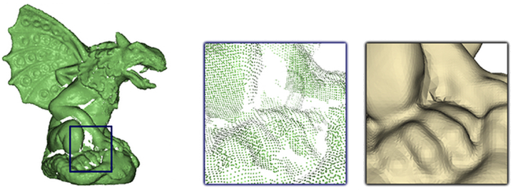
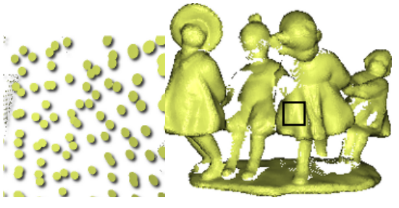
Challenges
Missing and noisy data
Hole filling
Scaling up to very large data sets
Non-uniform sampling
Data extrapolation
Image credits: Berger, Levine, Nonato, Taubin, Silva

Slide 6
Previous Work
Approximating approaches
Local
Hoppe et al. 92
Multi-level Partition of Unity Implicits (MPU)
Global
Radial basis functions
Graph-Cuts
Interpolating approaches
Delaunay triangulations
Alpha shapes
Voronoi diagrams

Slide 7
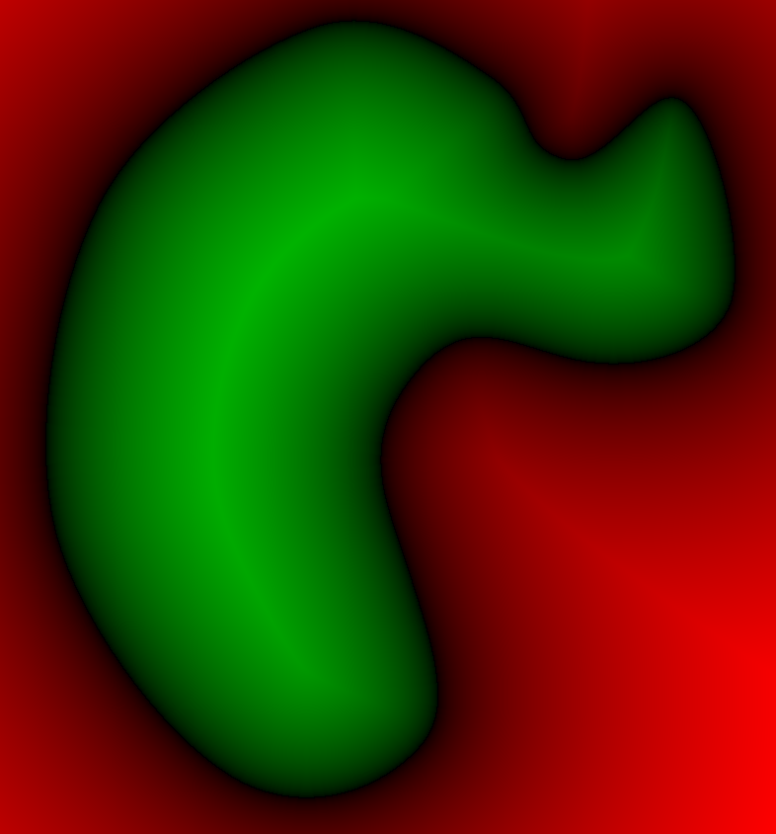
Implicit Approach
Define a function with value less than zero outside the model and greater than zero inside
Extract the zero-set
Marching Cubes
Guarantee watertight surfaces
< 0
0
> 0
Image credits: M. Kazhdan, M. Bolitho, H. Hoppe

Slide 8
Overview
Poisson Surface Reconstruction
SSD Surface Reconstruction
Results
Conclusion

Slide 9
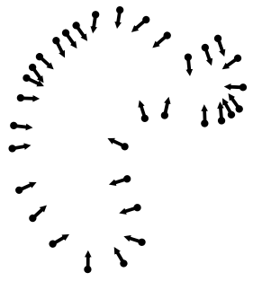
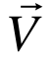
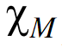
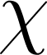
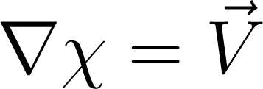
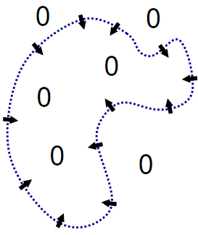
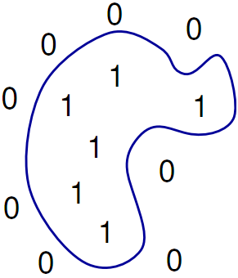
Poisson Surface Reconstruction
Problem
Given: Set of oriented points
Goal: Compute indicator function
Approach
Find a scalar function such that:
Problem
Not every vector field is a gradient of a function!
1
0

Slide 10
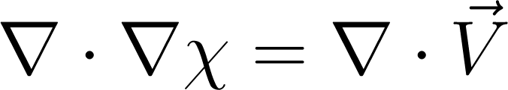
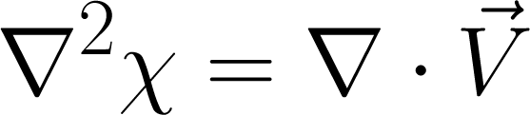
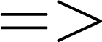
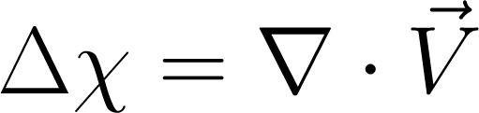
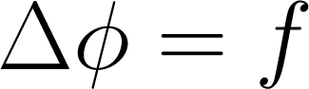
Poisson Surface Reconstruction
Approach
Solve in least-square sense
Apply the divergence operator to :
This is form of the Poisson equation
1
0

Slide 11
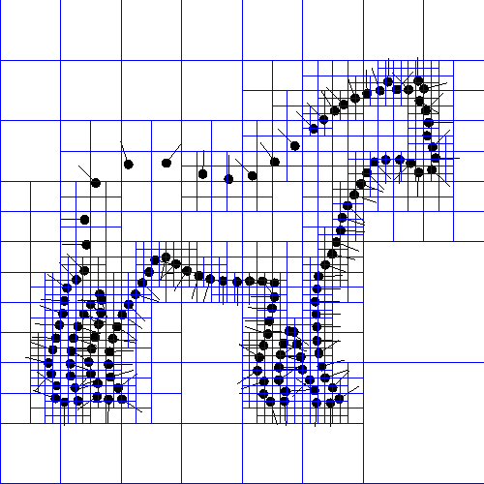
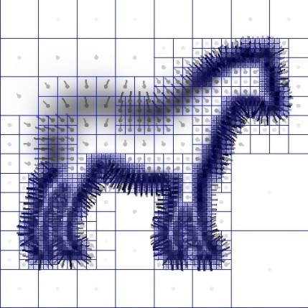
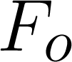
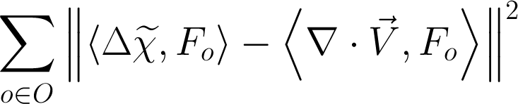
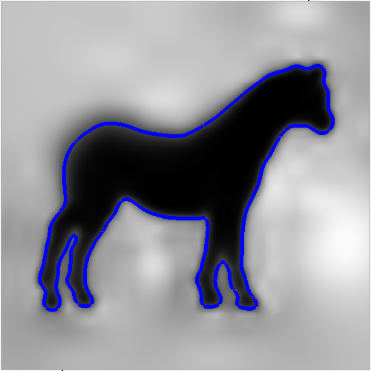
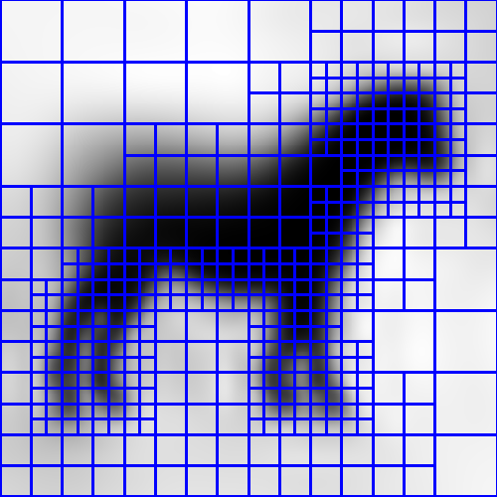
Implementation
Discretization: Octree
Need for accurate solution only near the surface
Extend vector field samples to a continuous 3D vector field
Function space
Basis functions
Compact support
Solve Poisson equation
Minimize
Extract isosurface
Determine isovalue
Marching cubes

Slide 12
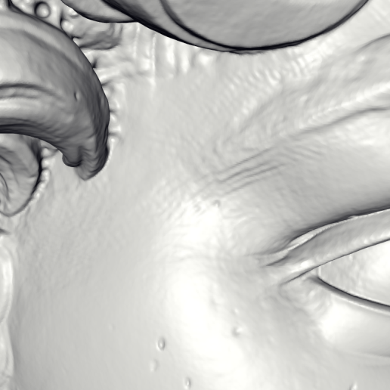
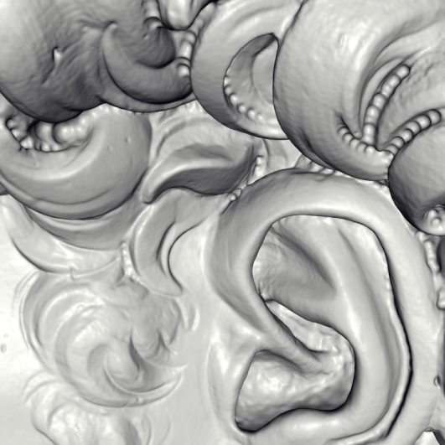
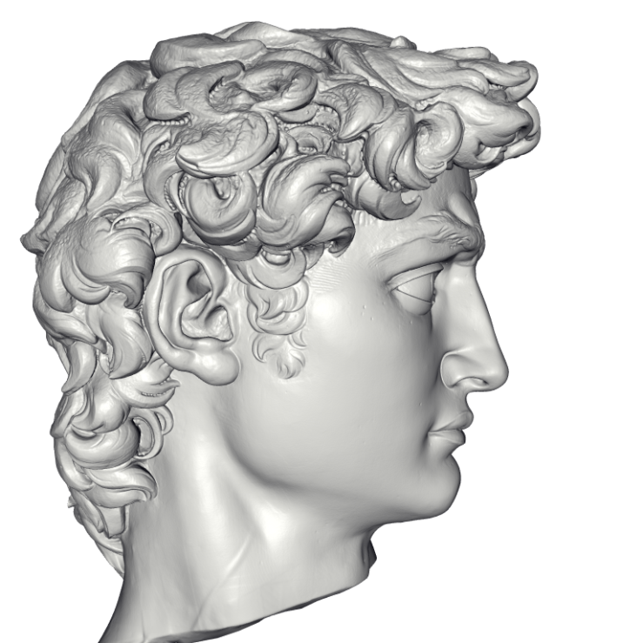
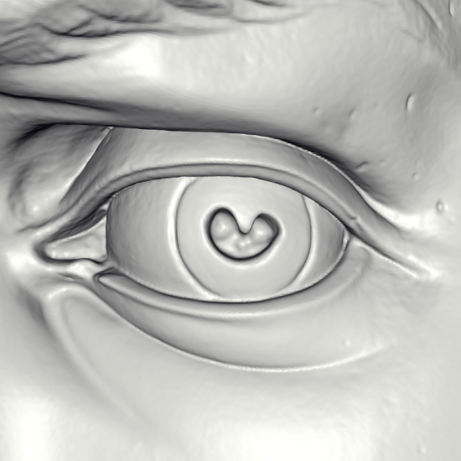
Results
Michelangelo’s David
215 million data points from 1000 scans
22 million triangle reconstruction
Computation time: 2.1 hours
Peak memory: 6600MB

Slide 13
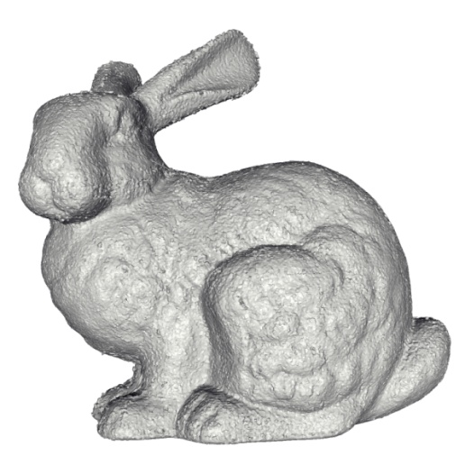
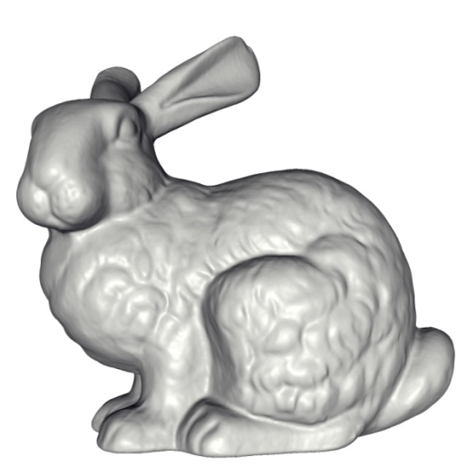
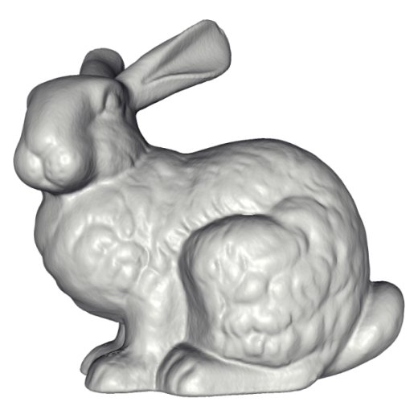
Results - Comparison
Stanford bunny
Power Crust
FastRBF
MPU
VRIP
FFT Reconstruction
Poisson

Slide 14
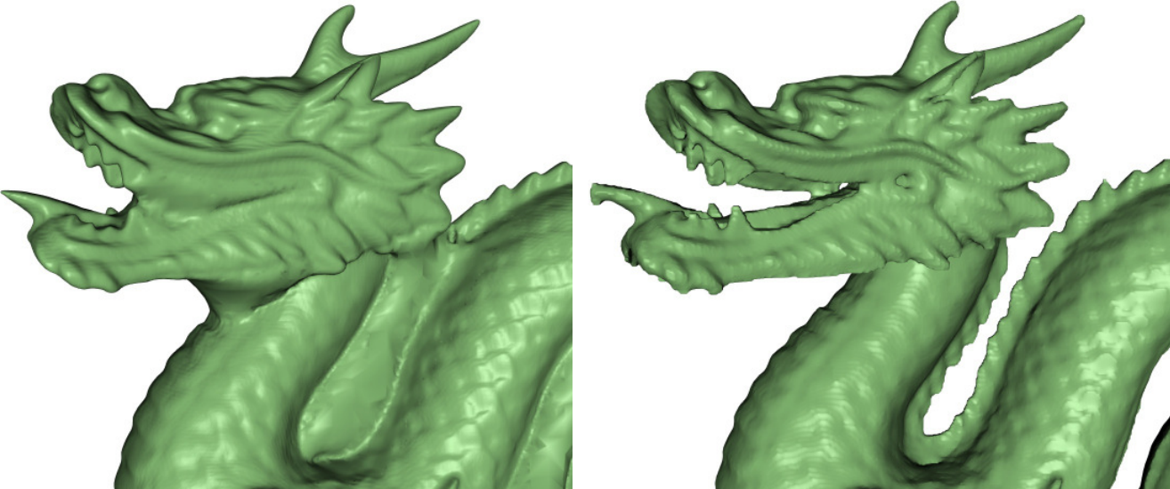
Results - Comparison
Stanford dragon
Poisson
Graph Cuts
Image credits: Lempitsky, Boykov: Global Optimization for Shape Fitting

Slide 15
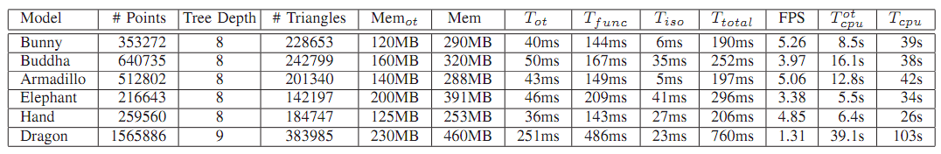
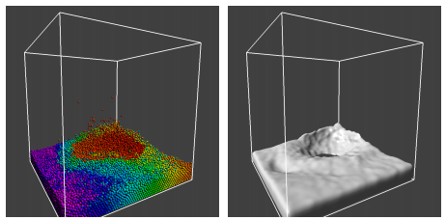
GPU Implementation
Data-Parallel Octrees for Surface Reconstruction
Kun Zhou, Minmin Gong, Xin Huang, Baining Guo, IEEE Transactions on Visualization & Computer Graphics, 2010
GPU implementation
Image credits: Kun Zhou, Minmin Gong, Xin Huang, Baining Guo

Slide 16
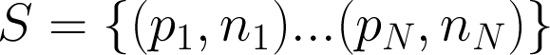
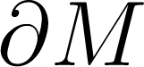

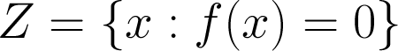
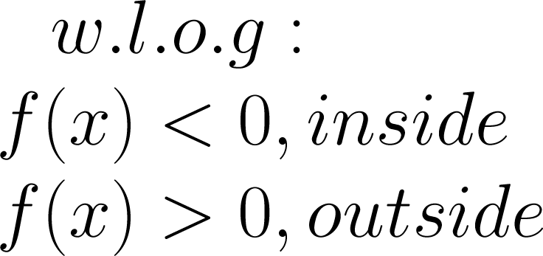
SSD Surface Reconstruction
Given:
Finite set of oriented points
Wanted:
Surface of solid defined by implicit function:

Slide 17
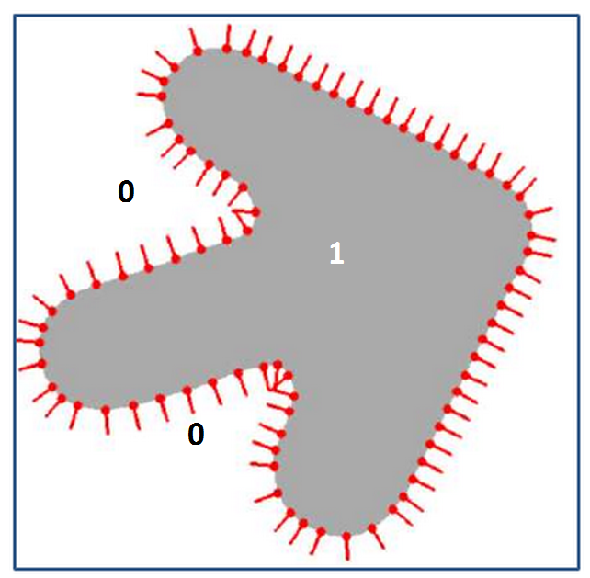
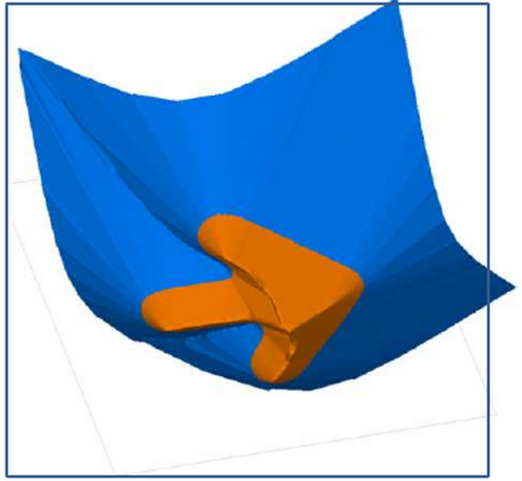
Continuous Formulation
Instead of indicator function, consider a smooth signed distance function
Indicator function
Smooth signed distance function
Image credits: F. Calakli, G. Taubin

Slide 18
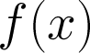
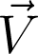
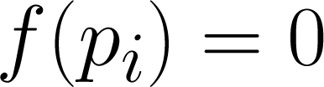
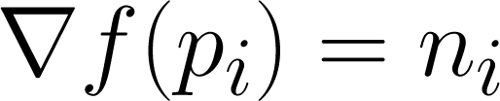


Variational Approach
Again, want to find the implicit function whose gradient best matches the observed vector field (in a least square sense)
Intuition
Implicit function should satisfy and
Hence data energy:

Slide 19



Energy Functional
How should behave away from data points?
Regularization term
is a Hessian matrix
Frobenius norm
Makes gradient of function almost constant away from the data
Enforces low curvature when strongly weighted
Image credits: F. Calakli, G. Taubin

Slide 20





Energy Functional
Total energy
Data term
Regularization term
Weights and

Slide 21







Implementation
Families of functions linearly parameterized by finite number of parameters
or
Smooth basis functions
Quadratic equation (positive semidefinite, non-homogeneous):
Global minimum by solving:
is a finite set with K elements

Slide 22




Energy Minimization
Contribution of energy terms to matrix A and vector b:

Slide 23
Energy Minimization
When K is small, solving is easy
But for good quality, we need large degree of freedom!
Basis functions should be compact
Otherwise matrix A is dense!
Families used in [3, 4] would be appropriate
Problem
Computing integrals associated with regularization term can result in significant implementation complexity

Slide 24


Alternative approach
Approach can be extended to basis functions continuous up to the first order
As long as , and can be written as linear combination of same parameters F:

Slide 25



Hybrid FE/FD Discretization
Finite element discretization for function
Finite differences discretization for gradient and Hessian
Advantages
Simple to implement
Applicable to adaptive grids (e.g. octree)
High-quality results at high-speed

Slide 26






Hybrid FE/FD Discretization
Hexahedral grid partition of space, volume V
Each axis divided into - segments cells
Grid vertices , multi-indices
Cells ,
Image credits: F. Calakli, G. Taubin

Slide 27





Hybrid FE/FD Discretization
Evaluate at grid vertices,
Finite element discretization of
Trilinear interpolation within each cell
Finite differences discretization for the gradient:
Evaluate within each cell

Slide 28






Hybrid FE/FD Discretization
Square norm of Hessian
Piecewise constant gradient
Integral over volume V reduces to finite sum over the faces
Where:
and is the area of face between cells and

Slide 29








Octree Implementation
Elements of matrix A and vector b are accumulated by traversing the octree
For each point in nonempty cell :
Add terms to and
and are indices of 8 vertices of the cell
For regularization term, traverse the dual graph
For each dual edge connecting the cells and add terms to elements
Here, and are
indices of the vertices
of the cells
Image credits: F. Calakli, G. Taubin

Slide 30
Solving Linear System
Exploit multiresolution structure
Iterative cascading multigrid approach
Solve problem at coarse level
Use the solution at that level to initialize the solution at the next level
Refine with using conjugate gradient solver

Slide 31



Isosurface Extraction
Dual Marching Cubes [13]
Compute the dual graph
Compute values of the implicit function at centroids of the octree cells
Simply average values at the vertices of the cell
Apply Marching Cubes on the dual graph
Image credits: Stanford (left), S. Schaefer, J. Warren (right)

Slide 32
Results
SSD outperforms other methods in complicated data sets
Test criteria
Non-uniform sampling
Sensor noise
Missing data
Performance comparable (CPU implementation)

Slide 33


Results
Michelangelo’s David’s head
1 million data points from many laser scans, uniform sampling, accurate normals
Point cloud
MPU
Poisson
D4 Wavelets
SSD

Slide 34



Results
Michelangelo’s David’s eye
Left eye taken from raw Michelangelo’s David data set
Uniform sampling, inaccurate normals
Point cloud
MPU
SSD
Poisson
D4 Wavelets

Slide 35


Challenging data sets
Virtual horse
100,000 samples, non-uniformly sampled, accurate normals
Chiquita
705,375 samples, structured light, non-uniformly distributed, inaccurate normals
Point cloud
MPU
Poisson
D4 Wavelets
SSD
Point cloud
MPU
Poisson
D4 Wavelets
SSD

Slide 36

Results
Hausdorff distance

Slide 37
Conclusion
New variational method for surface reconstruction
Sparse linear system with a global solution
Simple implementation
Extendable to adaptive data structures
Very good reconstruction quality
Performs especially well on the challenging data sets
Reasonable in terms of the reconstruction speed and memory consumption

Slide 38
Thank you for your attention.
Questions?

Slide 39


References

Slide 40


References

Slide 41

References

Slide 42




Finite Differences Method
Principle:
Derivatives are approximated by linear combinations of function values at the grid point
Discretize function on a grid for step
Approximate derivatives
First-order derivatives
Second-order derivatives

Slide 43

Finite Elements Method
Idea
Divide domain into subintervals – finite elements
Interpolate function value inside of the elements
Define properties of elements and their relationships
Assemble elements into a system
Define their relationships
Solve the system
Easily applied to complex, irregular-shaped objects
Successfully applied to several engineering problems

Slide 44






Computing Gradient Field
Problem
is discontinuous
Relationship between the gradient of the smoothed indicator function and the surface normal field:
Approximation of the gradient field:

Slide 45

Implementation
Octree
Discretization of the problem
Need for accurate solution only near the surface
Reduction of computational and storage complexity
Function space
Basis functions
Centered to leaf nodes and scaled accordingly
Compactly supported
Image credits: M. Kazhdan, M. Bolitho, H. Hoppe

Slide 46
Implementation: Indicator Function
Compute indicator function
Compute divergence
Solve Poisson equation
Minimize:
Isosurface extraction
Select isovalue
Marching cubes
Image credits: M. Kazhdan, M. Bolitho, H. Hoppe

Slide 47
Poisson Equation
Alternative interpretation
Minimization problem
Computes function whose gradient is closest to some prescribed vector field (in L2 norm sense)
…

